Slide 1
Parking Management System
One solution for all the vehicles parked in huge parking lots.

Slide 2
Our Team
Ankur Kapuriya
Prins Mathukiya
Namra Mehta
20DCE049
20DCE057
20DCE059

Slide 3
Introduction
A Parking Management System Project in javascript is used to manage and solve the Parking Problems of any company, institute or organisation.
This project is build on javascript using VS code.
The main objective for developing this project is to reduce the traffic problems in the parking place.
It gives information about every single vehicle parked in huge range of parking spaces – small or big.

Slide 4
Limitation of current parking lots
01
02
03
04
No info about vehicles
Wastage of paper
There are no records maintained of the vehicles which are currently parked in the lot.
The traditional parking system includes paper receipt which directly leads to its wastage.
Improper collection of charges
No past Records
There is no proper and fixed charges collection in the traditional system.
No records are maintained of the vehicles once left the lot.

Slide 5

01
About Our Project

Slide 6
About our Project
The website which we will be developing is the best solution for all the above mentioned limitations.
It will be time saving, productive and helpful to every single company. Simultaneously maintaing a proper record of all the vehicles parked in the past or parked currently.

Slide 7
Reference links
https://youtu.be/nXZ-J-CDrLU
https://www.tutorialspoint.com/javascript/index.htm
https://www.w3schools.com/js/
https://stackoverflow.com/
https://www.javatpoint.com/css-tutorial
https://youtube.com/playlist?list=PL0b6OzIxLPbx-BZTaWu_AF7hsKo_Fvsnf

Slide 8
SNEAK PEEK AT THE PROJECT

Slide 9
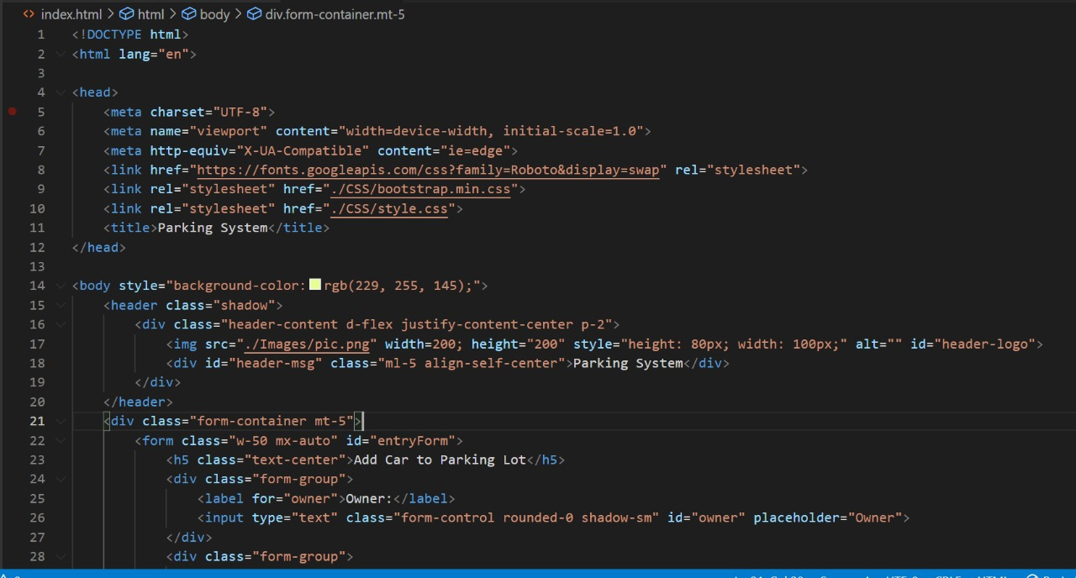

Slide 10
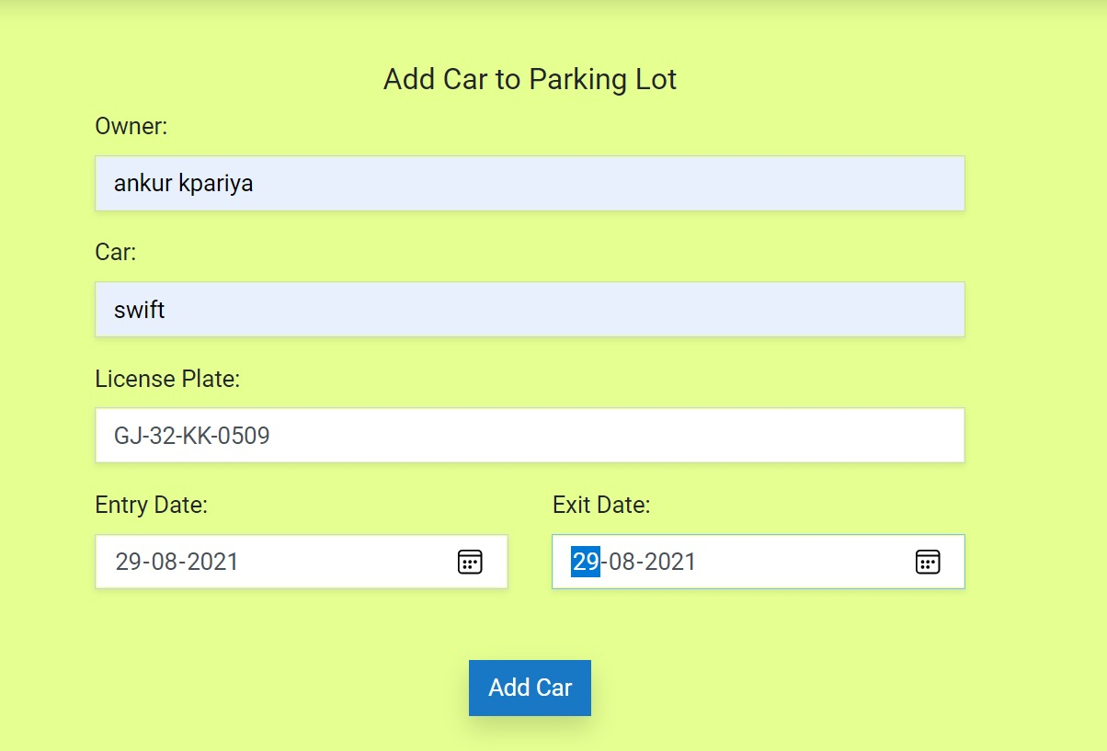

Slide 11
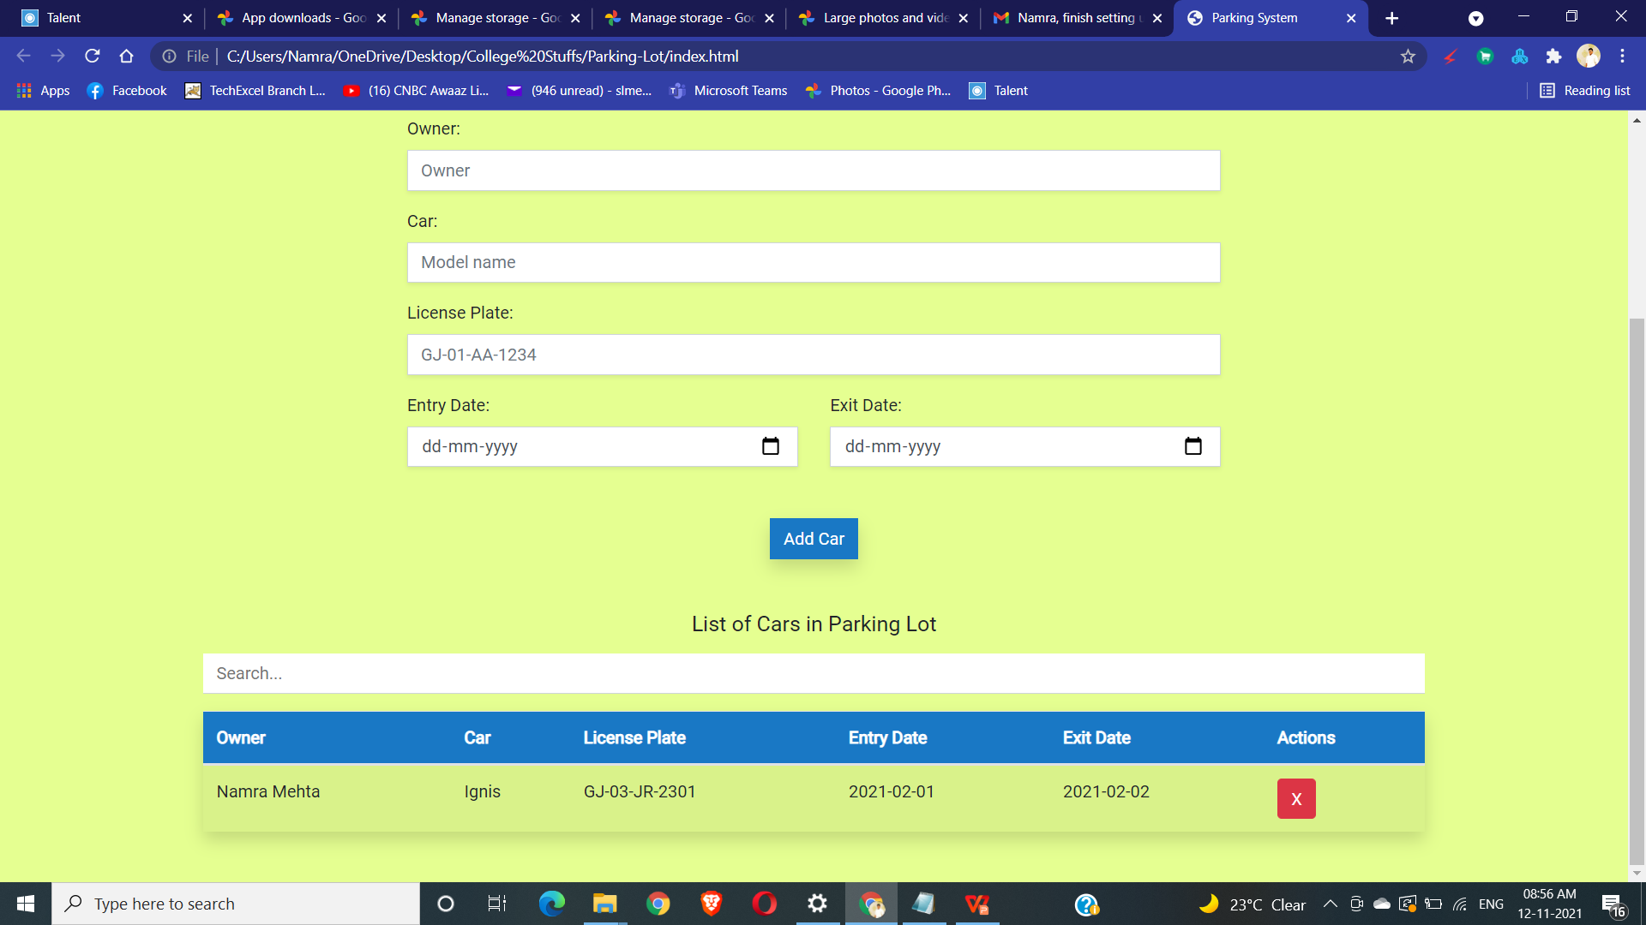

Slide 12
THANKS

